Slide 1




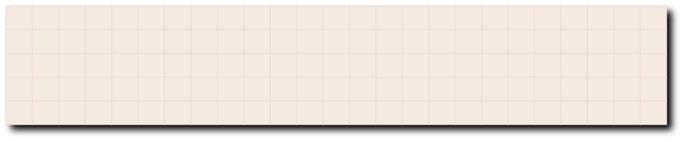
HOMEWORK
LAYOUTING UI
Chasetyo Ivan Yusaga

Slide 2

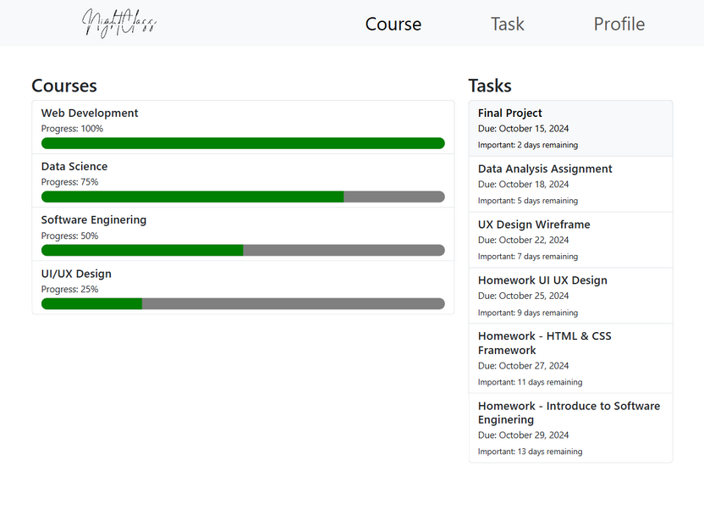
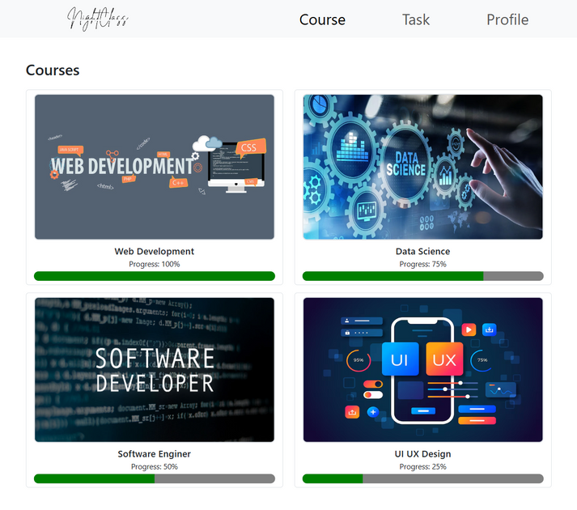
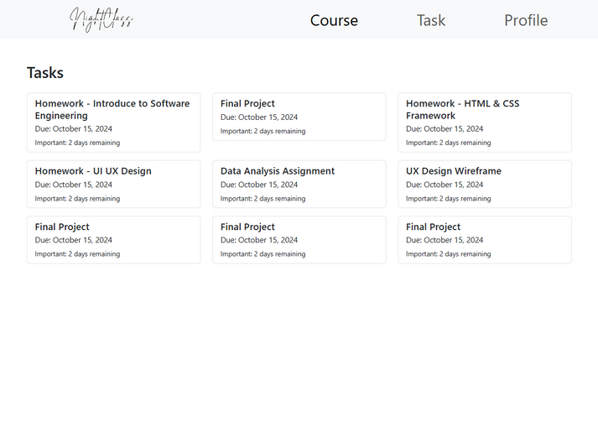
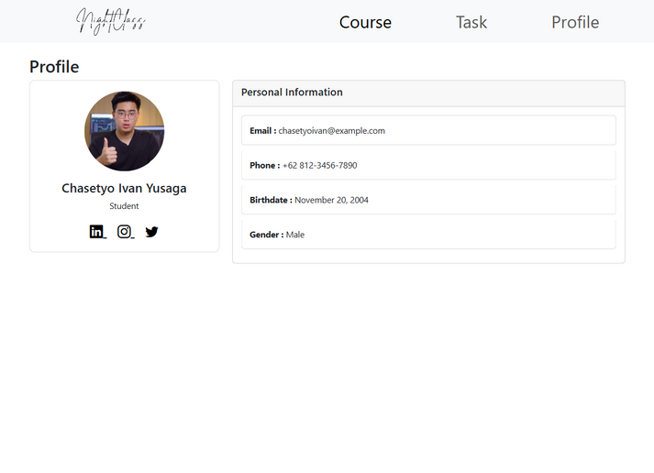
TAMPILAN WEB

Slide 3
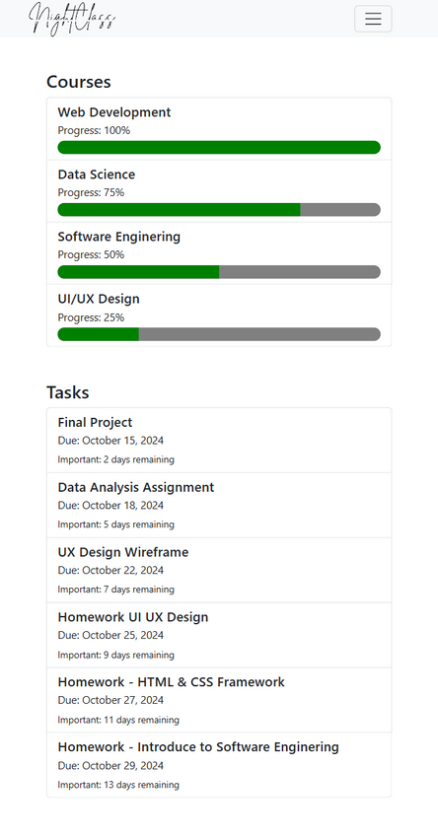

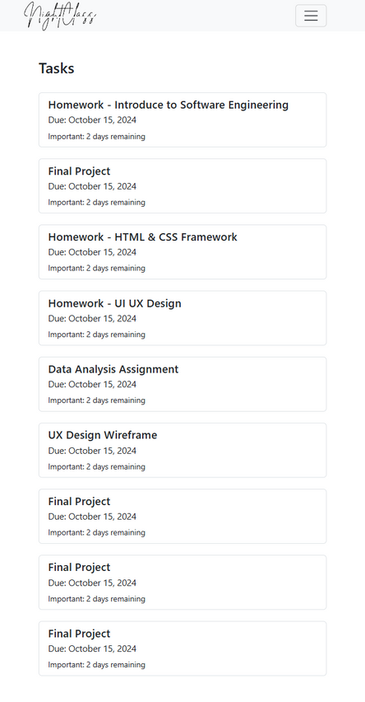
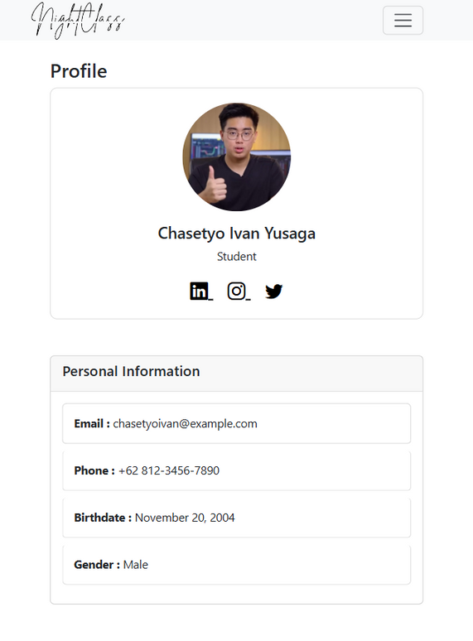
TAMPILAN MOBILE

Slide 4
LINK
Link Demonstrasi
https://youtu.be/BtbX36grKVQ
Link Github
https://github.com/IvanYusaga/WebsiteCourse

Slide 5

TERIMA KASIH

